Slide 1

ALEXNET
The Revolution That Powered Modern AI
ANN COURSE PROJECT

Slide 2

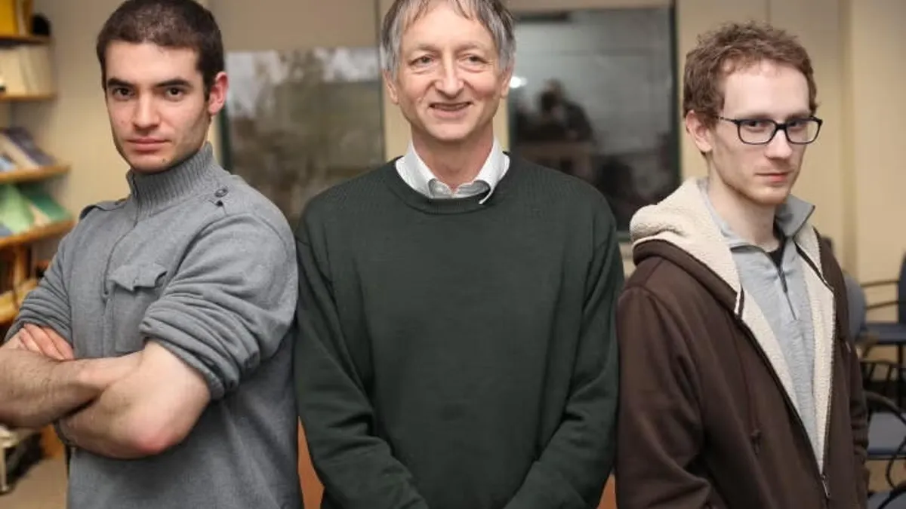
What is AlexNet?
Designed by Alex Krizhevsky, Ilya Sutskever, and Geoffrey Hinton in 2012, AlexNet is a groundbreaking Convolutional Neural Network (CNN).
Winner of ILSVRC 2012
First to use GPUs for large-scale training
Proved that deep learning beats manual engineering

Slide 3






Historical Context
Pre-2012
The Transition
Legacy
Computer vision relied on hand-crafted features like SIFT and HOG, which were limited in complexity and scaling.
AlexNet shifted the paradigm to "End-to-End" learning, where the network learns features directly from pixels.
This success ignited the "Deep Learning Summer," leading directly to the AI-driven world we live in today.

Slide 4
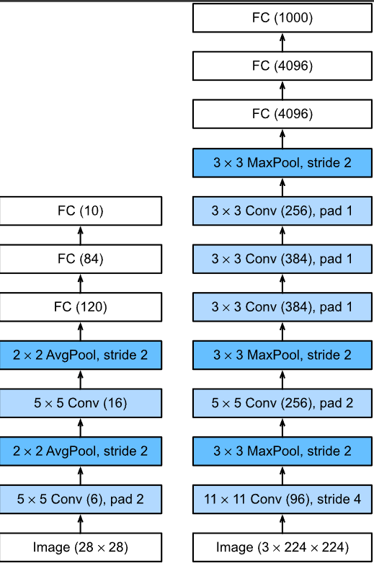
The 8-Layer Architecture
The network consists of eight trainable layers that progressively extract higher-level features.
5 Convolutional Layers: For feature extraction (edges, textures, shapes).
3 Fully Connected Layers: For high-level reasoning and classification.
Max Pooling: Integrated after Conv1, Conv2, and Conv5.

Slide 5
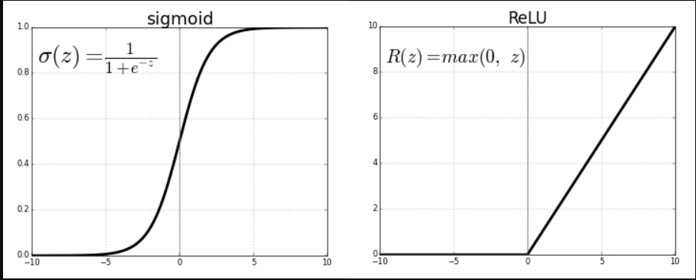

Innovation 1: ReLU
Before AlexNet, Sigmoid and Tanh were standard. AlexNet introduced the Rectified Linear Unit (ReLU).
This non-saturating nonlinearity allowed the network to train much faster than those using traditional saturating functions.

Slide 6

Why ReLU?
Speed & Convergence
Advantage Summary
AlexNet reached a 25% error rate on ImageNet 6 times faster using ReLU compared to Tanh.
Fast computation (simple threshold)
Non-saturating gradients
It effectively solved the "vanishing gradient" problem for deep architectures of that time.
Enables deeper training

Slide 7
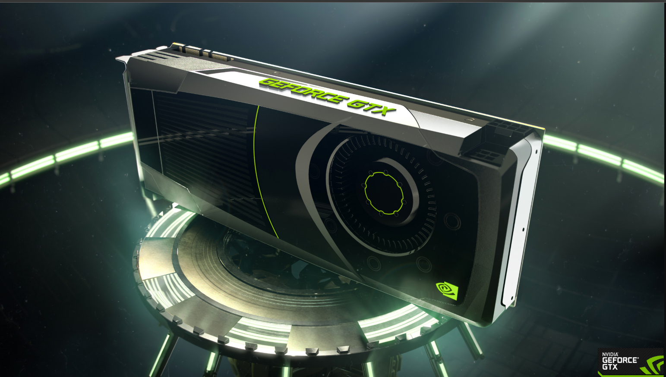
Innovation 2: Multi-GPU
In 2012, GPUs had limited memory (3GB). AlexNet was split across two NVIDIA GTX 580 GPUs.
Kernels were divided between GPUs.
Communication occurred only at specific layers.
This reduced training time to roughly 6 days for 1.2M images.

Slide 8
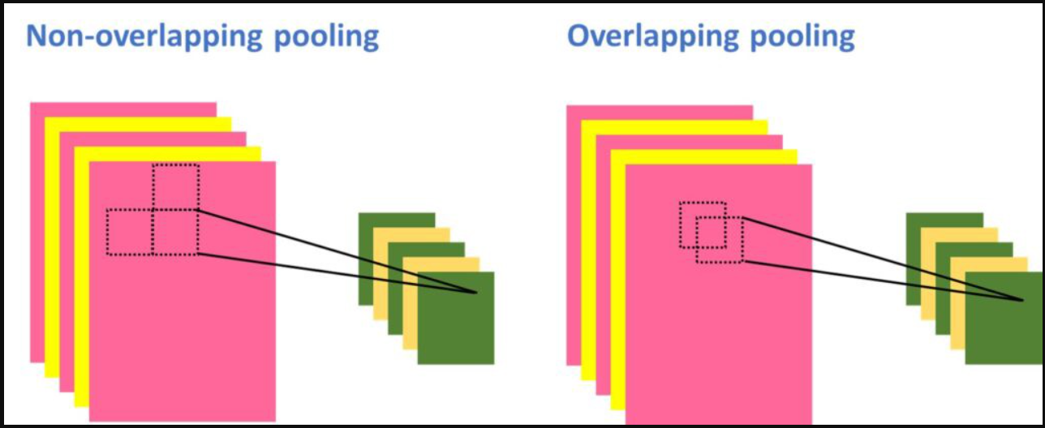

Innovation 3: Overlapping Pooling
Traditional pooling used non-overlapping grids. AlexNet used a stride smaller than the pooling window size.
Window Size: 3x3
Stride: 2
This scheme reduced top-1 and top-5 error rates by 0.4% and 0.3% respectively and made it harder to overfit.

Slide 9

Innovation 4: LRN
Local Response Normalization
Inspired by biological "lateral inhibition," LRN creates competition between neuron outputs at the same spatial location.
It normalizes the activation of a neuron relative to its neighbors across channels, enhancing high-contrast features and improving generalization. Though common in 2012, it was later superseded by Batch Normalization.

Slide 10
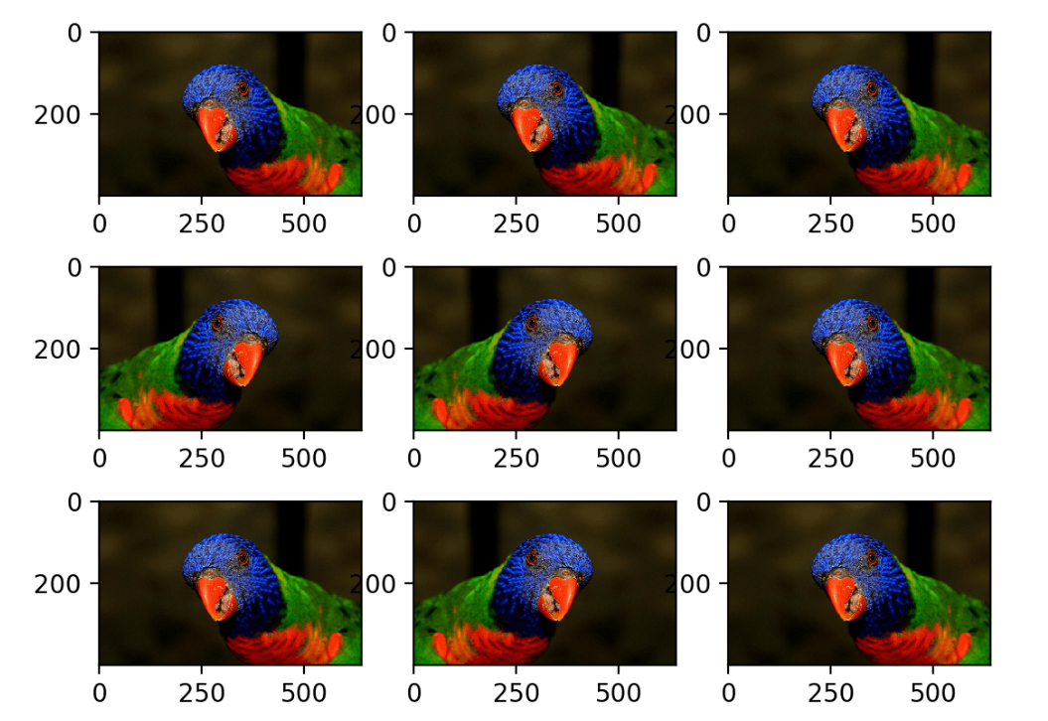
Combatting Overfitting
With 60M parameters, overfitting was the biggest threat. AlexNet used Data Augmentation:
Horizontal Flipping
Random 224x224 Cropping
RGB Intensity Shifting (PCA-based)
This increased the effective training set size 2048-fold.

Slide 11
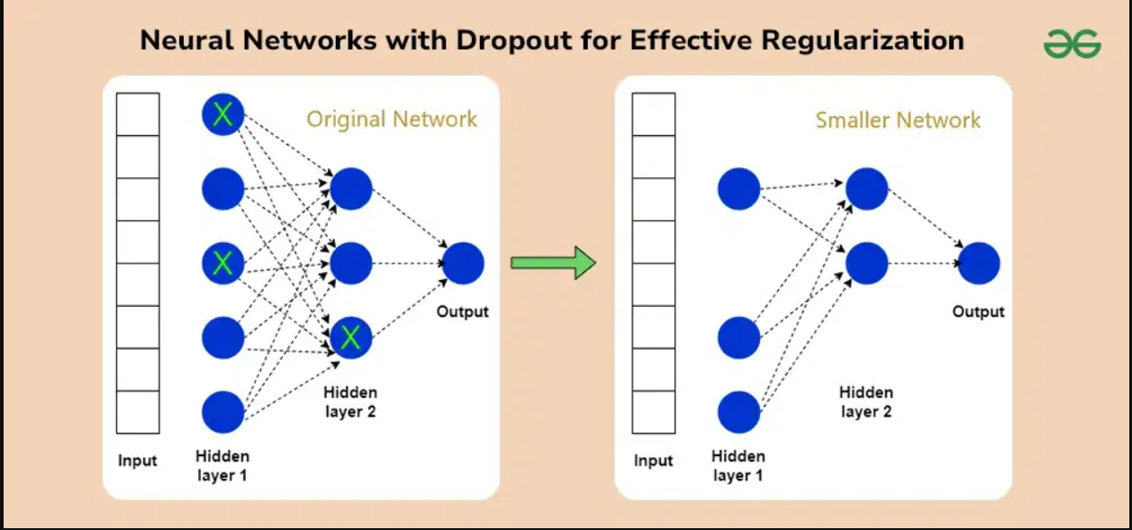
The Power of Dropout
Applied to the first two fully connected layers with a 0.5 probability.
Randomly zeros out neurons during training.
Prevents complex co-adaptations of neurons.
Forces the network to learn more robust, redundant features.

Slide 12


Layer 1: Input to Feature Map
Specs:
Input: 224 x 224 x 3 (RGB)
Kernels: 96 filters (11 x 11)
The output of Layer 1 is a 55x55x96 feature map, which is then processed by ReLU, LRN, and Max Pooling.
Stride: 4
The large 11x11 kernels were designed to capture broad, low-level features like edges and basic color blobs.

Slide 13
Deep Feature Extraction
Layer | Kernel Size | Filters | Notes
Conv 2 | 5 x 5 | 256 | Followed by LRN & Pooling
Conv 3 | 3 x 3 | 384 | Directly connected to Conv 2
Conv 4 | 3 x 3 | 384 | Directly connected to Conv 3
Conv 5 | 3 x 3 | 256 | Followed by Pooling

Slide 14



The Final Reasoning
FC6
FC7
FC8 (Output)
4096 Neurons. Receives flattened output from Conv5. Uses Dropout.
4096 Neurons. High-level conceptual mapping. Uses Dropout.
1000 Neurons. Softmax output for the 1000 ImageNet classes.

Slide 15
Total Complexity
60M
Most parameters reside in the FC layers.
Requires roughly 650,000 neurons.
Computational load was immense for 2012 hardware.
Trainable Parameters

Slide 16
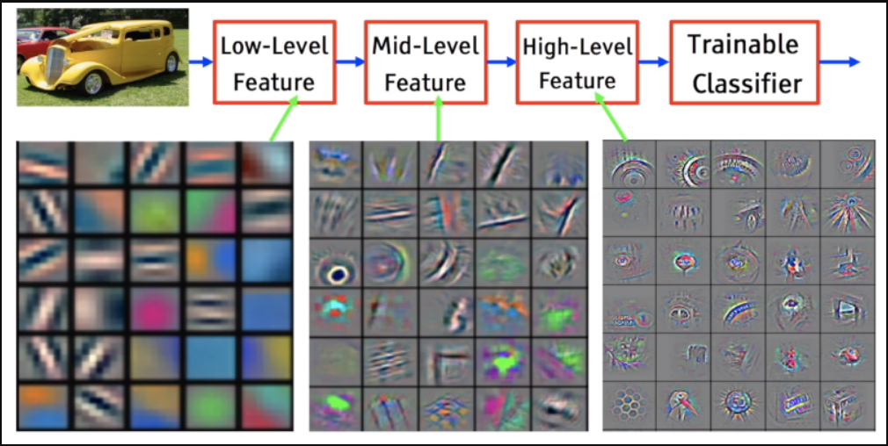
What the Model Sees
The first layer filters learn color blobs and frequency-orientation edges.
By visualizing these filters, we see that GPU 1 focused on color-agnostic edges, while GPU 2 focused on color-sensitive patterns.

Slide 17
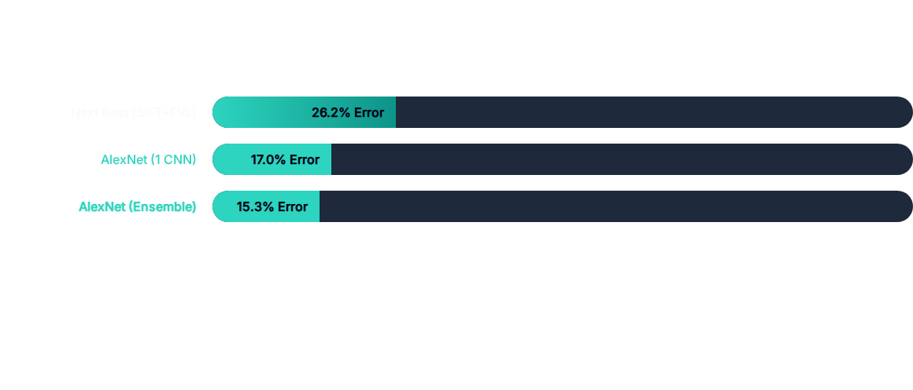
ILSVRC 2012 Results
AlexNet won by an unprecedented margin of 10.8% over the runner-up.

Slide 18
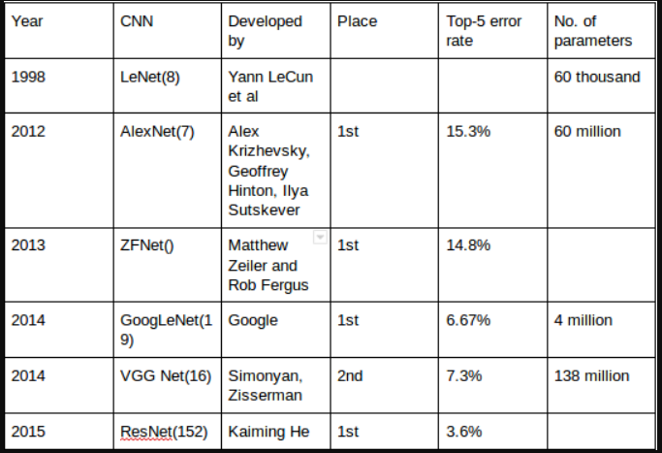
Evolution: LeNet vs AlexNet
Key Differences:
Scale: AlexNet is much deeper and wider.
Nonlinearity: Tanh/Sigmoid (LeNet) vs ReLU (AlexNet).
Regularization: AlexNet introduced Dropout.
Hardware: CPU (LeNet) vs GPU (AlexNet).

Slide 19






Limitations & Failure Cases
Computational Cost
Kernel Size
Bias
Extremely heavy for mobile or edge deployment. Modern models like MobileNet are 50x smaller.
11x11 kernels are computationally expensive and were replaced by stacked 3x3 kernels in VGGNet.
Trained on ImageNet, which in 2012 had geographic and Western-centric biases in labels.

Slide 20

What Came Next? (VGGNet)
While AlexNet proved the depth concept, VGGNet (2014) refined it by:
The Verdict
Using only 3x3 convolution filters.
AlexNet is the "Dinosaur" of Deep Learning—massive, powerful, but eventually evolved into sleeker, more efficient forms.
Increasing depth to 16-19 layers.
Proving that smaller kernels with more depth are more efficient.

Slide 21
“
Deep learning is not just about big data, it's about the convergence of data, algorithms, and computational power.
Conclusion
AlexNet was the spark. It didn't just win a competition; it changed the trajectory of human technology, leading to self-driving cars, medical AI, and LLMs.

Slide 22
QUESTIONS?
Artificial Neural Networks Project
Thank you for your attention.

Slide 23
Image Sources
https://www.zdnet.com/a/img/resize/cbdfcc9ffe02c07ec17d656be49e670a55e467ec/2025/03/20/1fff3c66-1148-433b-859b-e53ca710522c/u-of-toronto-2013-hinton-krizhevsky-sutskever.jpg?auto=webp&width=1280
Source: www.zdnet.com
https://upload.wikimedia.org/wikipedia/commons/a/ad/AlexNet_block_diagram.svg
Source: en.wikipedia.org
https://miro.medium.com/1*aEVZlqkcakVySV6ETqgfEg.png
Source: medium.com
https://cdn.mos.cms.futurecdn.net/SeFR7XjGGqt3DeeARQcBRb.jpg
Source: www.tomshardware.com
https://cdn.zaka.ai/files/2022/05/14145352/0-5h1EGGqtvyZujTSl.jpg
Source: zaka.ai
https://machinelearningmastery.com/wp-content/uploads/2019/01/Plot-of-Augmented-Images-with-a-Horizontal-Flip.png
Source: machinelearningmastery.com

Slide 24
Image Sources
https://media.geeksforgeeks.org/wp-content/uploads/20240702144440/Neural-Networks-with-Dropout-for-Effective-Regularization.webp
Source: www.geeksforgeeks.org
https://miro.medium.com/v2/resize:fit:1400/1*bIY_8FE7dJaGk1kjU7iVSg.png
Source: medium.com
https://miro.medium.com/v2/resize:fit:1078/1*q1QRxnGxg8COheh8tWXAiw.png
Source: medium.com

